Slide 1


AN EVALUATION OF TORONTO NEIGHBOURHOODS
FOR THE PLACEMENT OF A CARIBBEAN THEMED RESTAURANT

Slide 2
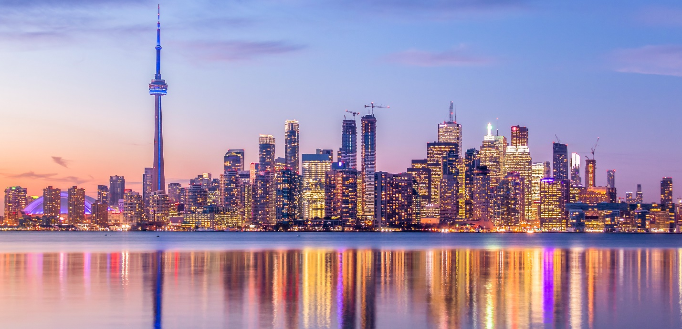
Table of Contents
Introduction
Conclusion
Methodology
Results

Slide 3
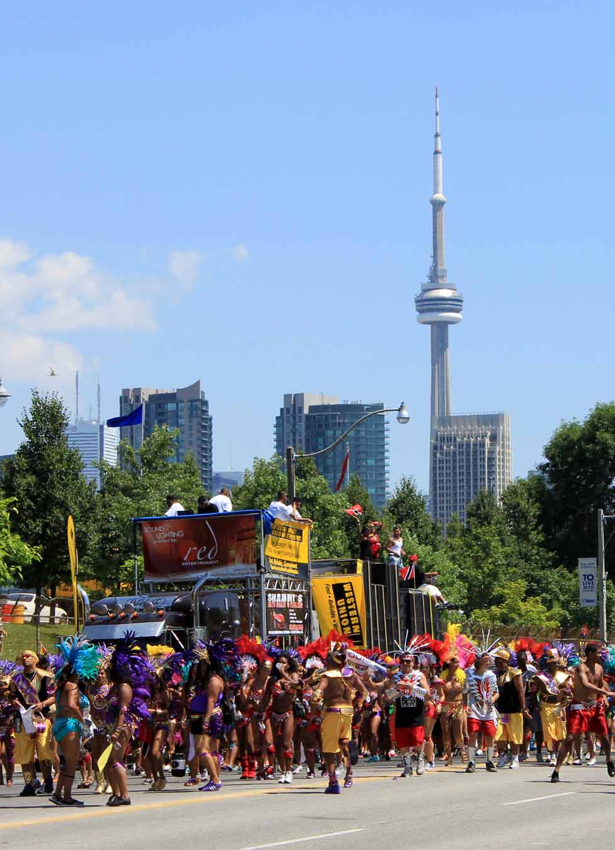
Introduction: Toronto and Caribbean Immigrants
The Greater Toronto Metropolitan Area is home to 6 million people
50% of Toronto residents belong to a visible minority group
160 languages are spoken in the city
500,000 Canadians are immigrants from the Caribbean
Fast growing ethnic group, +11% between ‘96 – ’01 vs 4% nationally
Caribana (Toronto Caribbean Carnival)

Slide 4

Methodology: Sources of Data
List of Canadian Postal Codes which contained information about neighbourhoods and their respective boroughs.
Geospatial Data which contained a list of latitude and longitude coordinates for Toronto neighbourhoods
Demographic Data which contained a list of neighbourhoods which information about population, population growth, income etc
Venue Data from Foursquare which contained venues and venue categories for the list of selected Toronto neighbourhoods

Slide 5
Methodology: Data Preprocessing
Merge Postal Codes with Geospatial Data
Download and merge Demographics Data
Download Venues Data from Foursquare
Calculate custom radius per neighbourhood
Onehot encoding to prepare data foe machine learning
Kmeans Algorithm used to classify neighbourhoods
Evaluation Metrics used to score best neighbourhoods

Slide 6
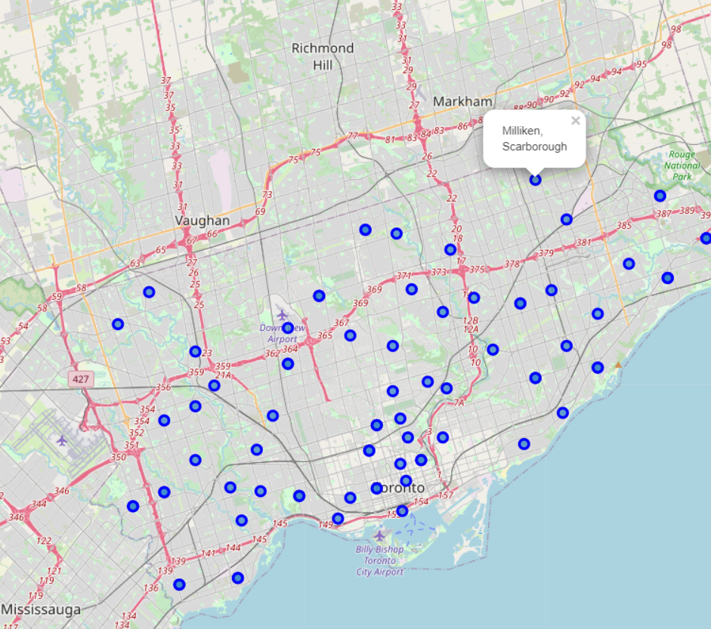




RESULTS: Toronto Neighbourhoods

Slide 7
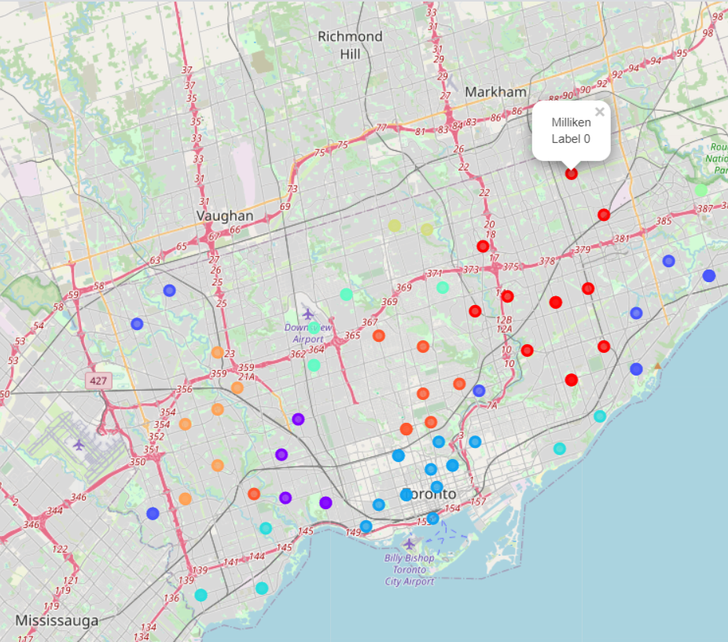
RESULTS: Toronto Neighbourhoods after Kmeans Classification

Slide 8
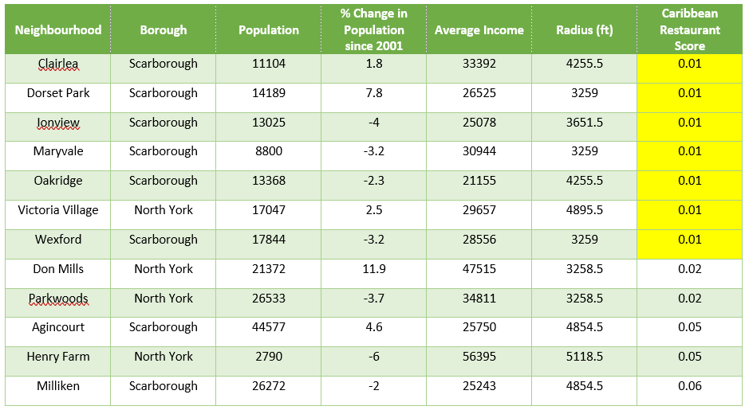
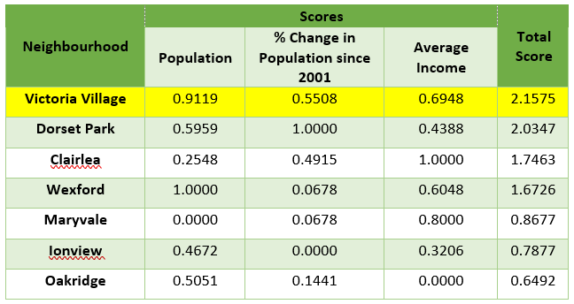
RESULTS: Selection of Best Neighbourhood

Slide 9

Discussion & Conclusion
Discussion
Inclusion of demographic data in kmeans analysis
No data on ethnic makeup of neighbourhoods
Arbitrary selection of kmeans hyperparameter
Use of kmeans in multidimensional problems
Conclusion
This report concludes that Victoria Village is the best choice for George’s Tastee Foods to open its second restaurant.
Neighbourhood is similar to Milliken
Competition is low with a relatively large, growing and affluent population
Relatively close to Milliken reducing potential transportation/logistics costs to support the new outlet as a satellite operation.

Slide 10

REFERENCES
Toronto Demographics:
https://en.wikipedia.org/wiki/Demographics_of_Toronto_neighbourhoods
Toronto Geospatial Data:
https://cocl.us/Geospatial_data
Toronto Postal Codes:
https://en.wikipedia.org/wiki/List_of_postal_codes_of_Canada:_M
Haversine Formula:
https://kite.com/python/answers/how-to-find-the-distance-between-two-lat-long-coordinates-in-python
KMeans Algorithim:
https://towardsdatascience.com/k-means-clustering-algorithm-applications-evaluation-methods-and-drawbacks-aa03e644b48a

